Slide 1
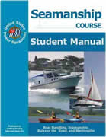
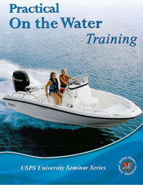

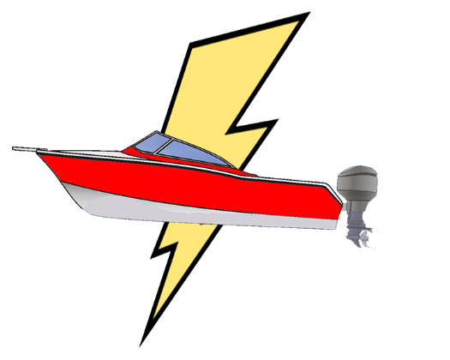

Four On-the-Water Programs
On-the-Water Guides
Hands-On Training
Boat Operator Certification
Jump Start

Slide 2
Program Comparison
Program | Objective | Instructor | Boat | Student | Price (to Squadrons)
Flexible Programs - Modify these to fit your on-the-water training needs
Jump Start Program | One-on-one training for the new boat owner | Anyone | Student’s Boat | Everyone | Free
On-the-Water Guides | Extend classroom training to on-the-water exercises | Anyone | Any boat | Everyone | Free
Credentialed Programs - Teaching and certifying on-the-water standards
Hands-On Training
Basic Powerboat | Teaches basic powerboat handling, no experience required (formerly POTW) | BOC Certifier | Power boat 16’-26’ | Everyone | $40 (free to members)
Large Powerboat | Teacher large powerboat handling (formerly Large Boat POTW) | BOC Certifier | Power boat > 26’ | Everyone | $40 (free to members)
Boat Operator Certification
Inland Navigator | Certify skills for basic boat handling | BOC Certifier | Power boat 16’-26’ | Member | $44 (+ classes & seminars)
Coastal Navigator | Certify skills for basic coastal navigation | BOC Certifier | Any boat | Member | $44 (+ classes & seminars)
Advanced Coastal Navigator | Certify skills for advanced coastal navigation | BOC Certifier | Any boat | Member | $44 (+ classes & seminars)
Offshore Navigator | Certify skills for offshore navigation | BOC Certifier | Any boat | Member | $44 (+ classes & seminars)

Slide 3
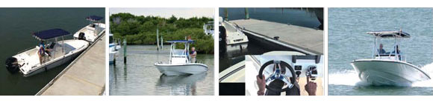
Hands-On Training
Formerly known as Practical On-the-Water Training (POTW)
Boat handling skills for new and experienced boaters
Covers the ANSI standards for powerboat
Includes 4 hours in the classroom + 4 hours on the water
Two versions of Hands-On Training:
  Basic Powerboat – Boats under 26’
  Large Powerboat – Boats over 26’
Instruction requires a BOC-IN or Basic Powerboat Certifier

Slide 4
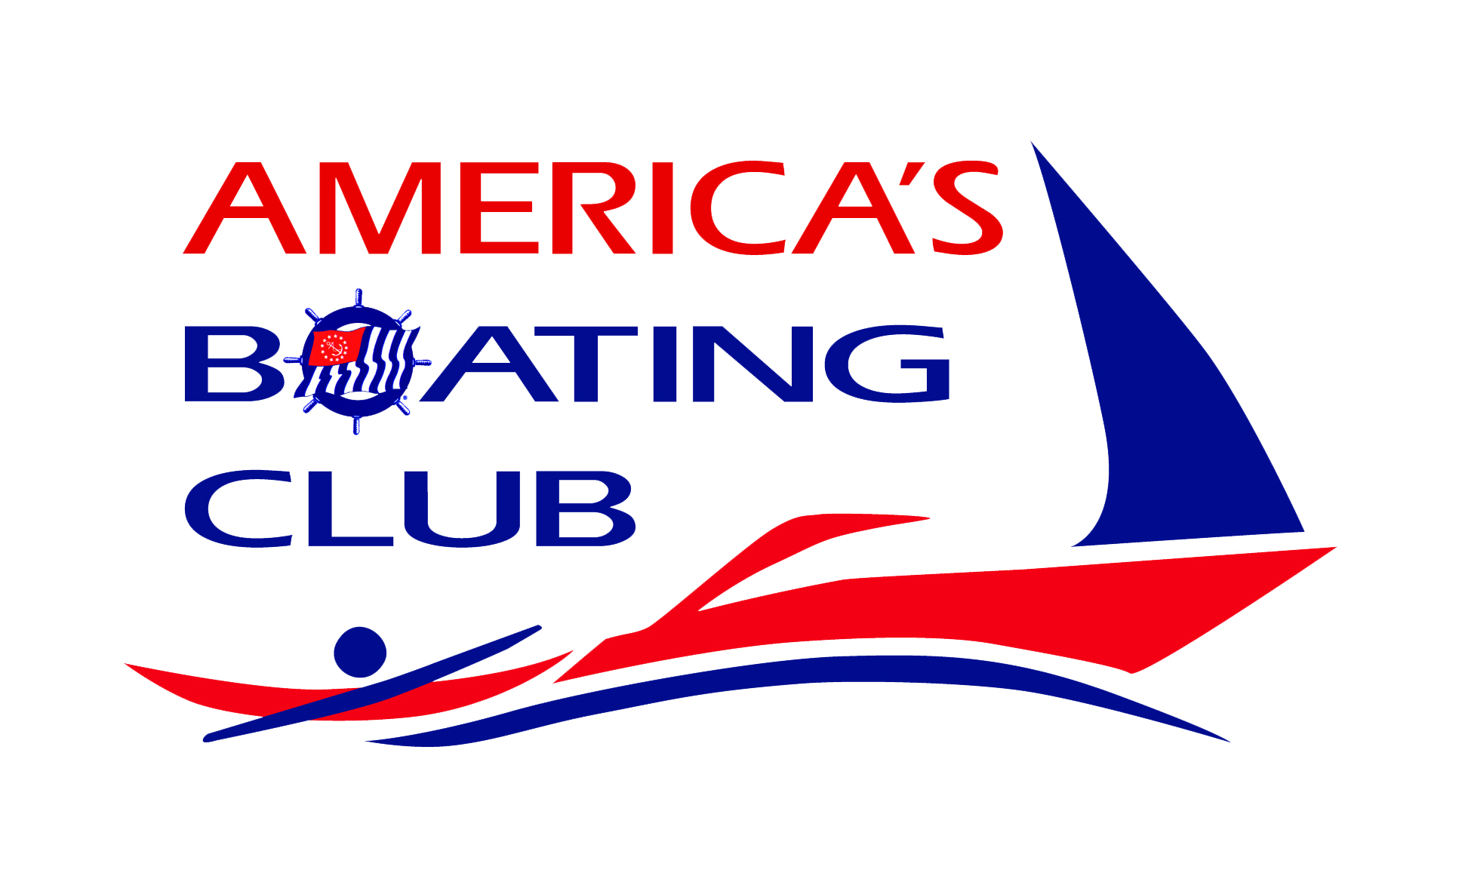
HOT Policy - 2019
  The Hands-On Training (HOT) program was developed by USPS titled
  Practical On-The Water training. The name was changed to Hands-On Training in 2017. The program is structured to be the same with only administrative changes.

Slide 5
HOT Administrative Structure
HOT is now divided into two separate sections:
  1. Classroom Seminar
  2. On-The Water Training
These two sections are linked together.
The classroom seminar is mandatory while the on-the water training is optional. However, to get credit for HOT both sections are required.

Slide 6
HOT Administrative Structure
The classroom seminar (the morning session) has no financial restrictions for the training or other charges (such as charging for lunch).
The on-the water session (usually in the afternoon) is offered at no charge to the student, thus complying with USCG rules and regulations.
Squadrons are free to charge for the classroom seminar to cover the costs of the program and not have any concern about the legality of the training.

Slide 7
HOT Exercises
Close quarters maneuvering
    Using lines effectively near the dock
    Departing the dock
    Operating in fairways & tight areas
    Pivot Turn
    Mooring to a bouy
    Backing
    Docking
➲
Notes:
There are two basic categories of maneuvers we use to learn and practice:
Close Quarters Maneuvering – in and around docks and obstacles.
And Protected Open Water exercises.
PAUSE & POINT
With close quarters maneuvering, they will practice using lines effectively near the dock, departing from the dock, operating in fairways and tight areas, pivoting, approaching a mooring, backing, and of course, docking.

Slide 8
HOT Exercises (Continued)
In Protected open water
    Maneuvering to the exercise area
    Steering - slalom
    Holding course
    Run a range
    Quick stop
    Uses a bouy kit (instructions on line)
➲
Notes:
Part of the open water maneuvers involves getting to and from the exercise area. This will be accomplished complying with all of the navigation rules, maintaining proper speed and going onto a plane where possible.
PAUSE & POINT

Slide 9
Open Water
➲
Notes:
The exercises include both slow and high speed slaloms, running a range toward and away, and a quick stop maneuver

Slide 10
HOT Policy - 2019
  Non-members of USPS are required to purchase the HOT student training kit available to squadrons on the USPS website. In addition squadrons may add local expenses.
  USPS Members are not required to purchase the HOT student kit training, however it is acceptable to have members share in the local expenses

Slide 11
HOT Policy - 2019
HOT is a credentialed program, part of the Boat Operator Certification program.
The classroom seminar may be taught by any USPS certified instructor.
For the student to receive credit for the training, the on-the-water component must be taught by a BOC-IN or HOT (Basic) Certifier (see BOC manual for information).
Students who do the on-the-water training with a BOC IN-Certifier are then certified for the on-the-water portion of the BOC-IN Certification.

Slide 12
HOT Policy - 2019
  HOT is normally taught in one day. In the morning the mandatory HOT seminar is taught. The afternoon is spent on the water. However, squadrons can teach HOT over two days (or evenings) if desired.

Slide 13
Qualifications for Basic Powerboat Certifier
1. Be a USPS member.
2. Be nominated and approved by the RD or ARD.
3. Be a current USPS Certified Instructor and maintain that status.
4. Have completed a NASBLA-approved course, Boat Handling, and the BOC boat handling skill demonstration.
5. Have completed the Certifier’s seminar
6. Have substantial, verifiable on-the-water experience.
7. Be able to observe and document on-water skill demonstrations.
8. Have internet access and an e-mail address.
9. Use the electronic database system.

Slide 14
Questions?
>>
Notes:
Why go through a Boat Operator Certification?
Here are some of the reasons to go through the effort of getting a Certification.
PAUSE & POINT
The lower four bullets are a little more speculative (an scary)

Slide 15
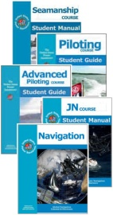
On-The-Water Guides
Extends existing classroom with relevant exercise on the water
Participation is optional, and not required for course completion
Framework developed by the BOC Committee
Individual guides created by each Education Department Committee
Guides are downloadable from the Committee Pages on the National web site
Guides available for Advance Grade courses, Sailing, and ABC3
Anyone can teach with Squadron approval

Slide 16
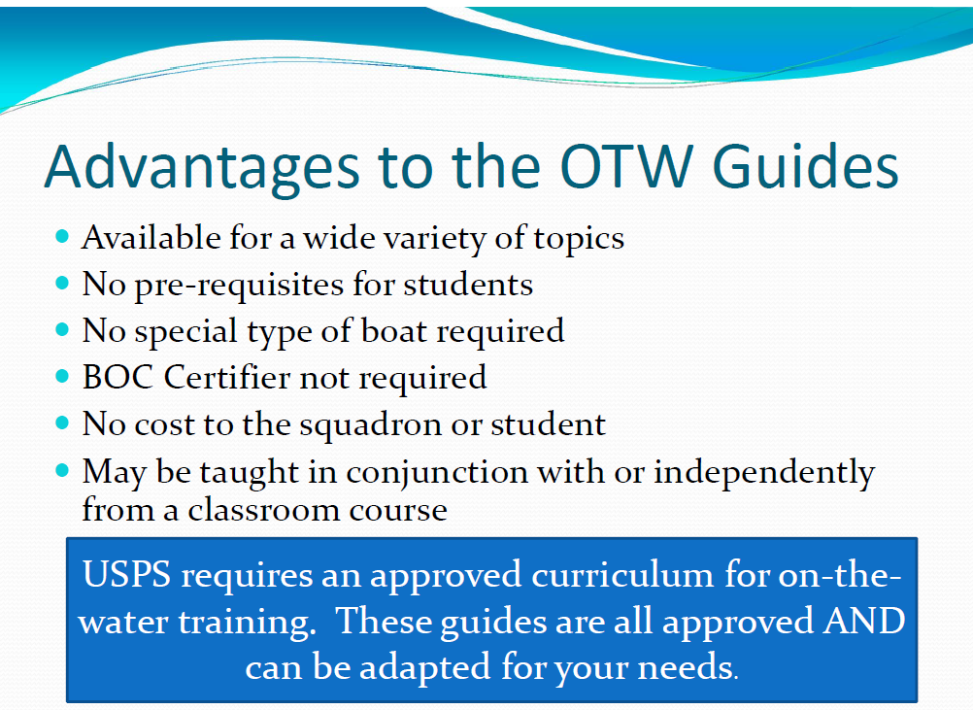
On-The-Water Guides

Slide 17
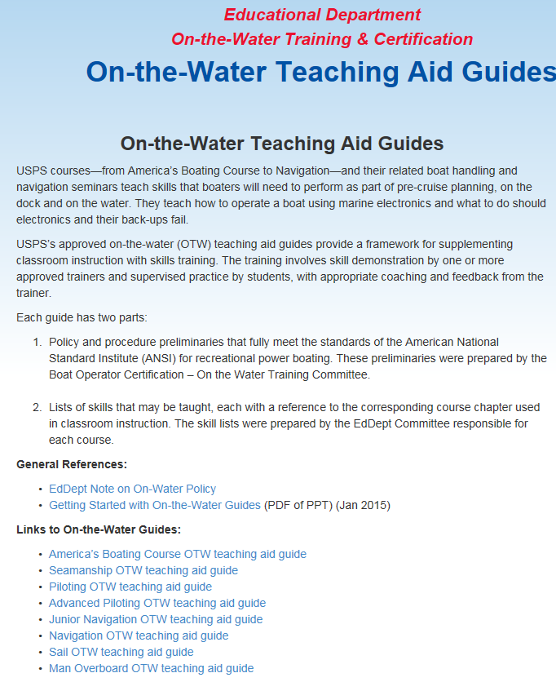
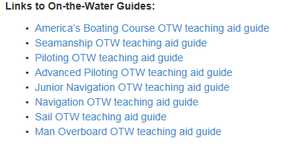
On-The-Water Guides
Available on the Educational Dept Web Pages

Slide 18
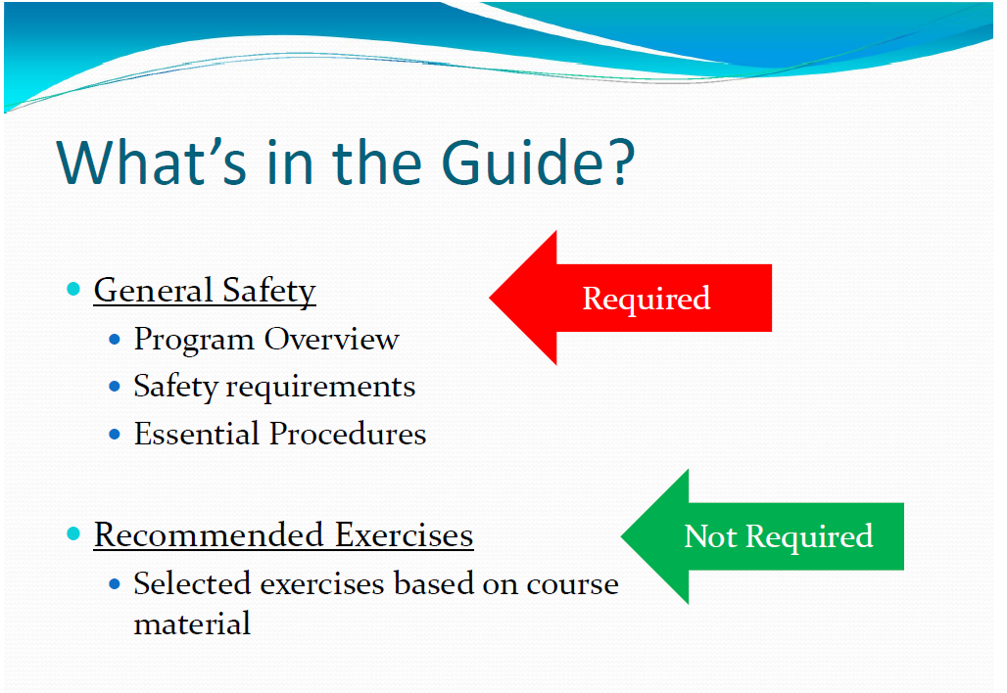
On-The-Water Guides

Slide 19
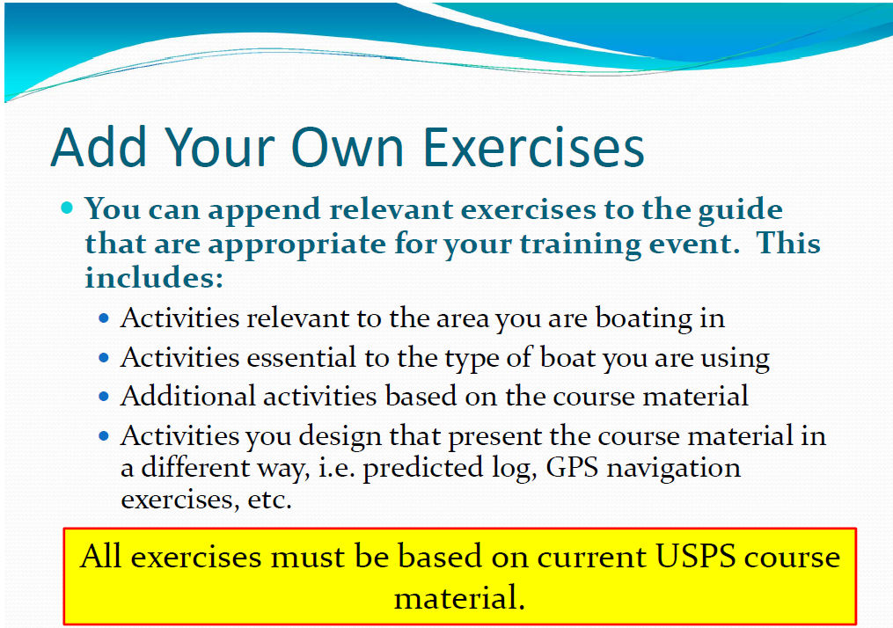
On-The-Water Guides

Slide 20
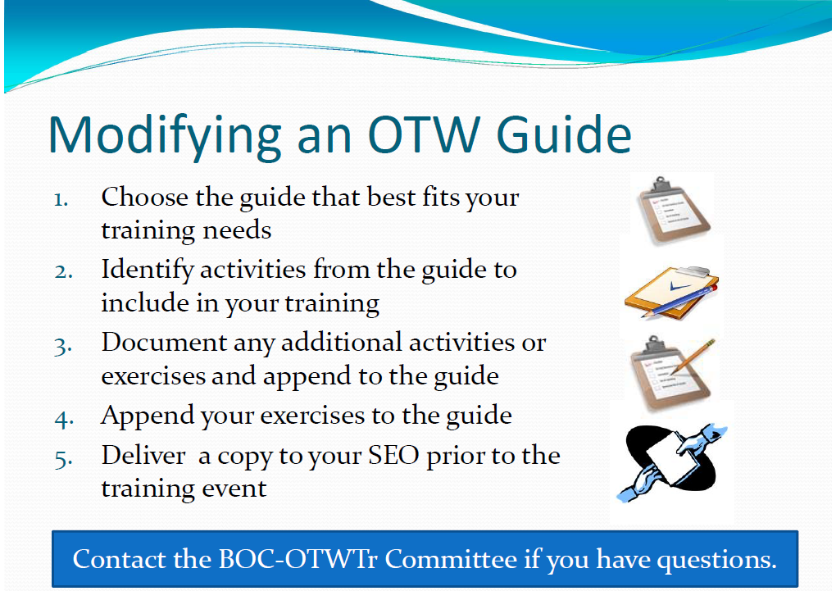
On-The-Water Guides

Slide 21
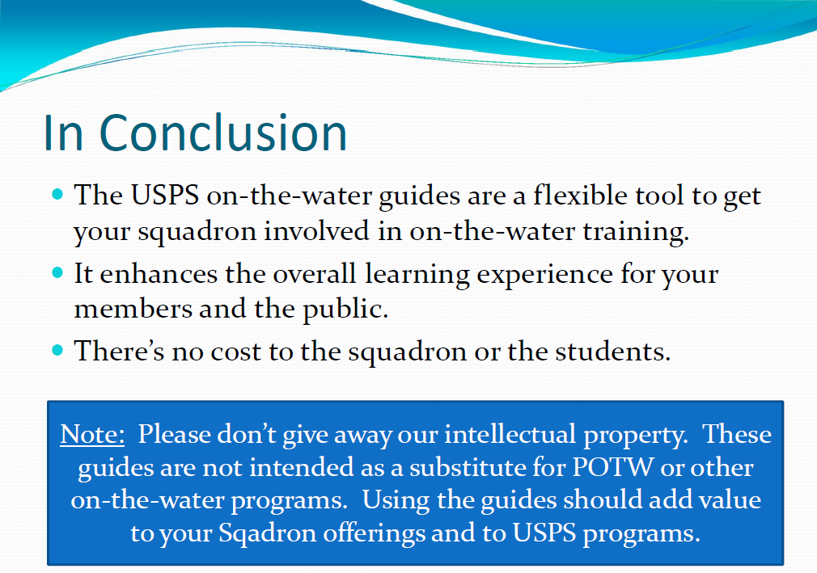
On-The-Water Guides

Slide 22
Questions?
>>
Notes:
Why go through a Boat Operator Certification?
Here are some of the reasons to go through the effort of getting a Certification.
PAUSE & POINT
The lower four bullets are a little more speculative (an scary)

Slide 23

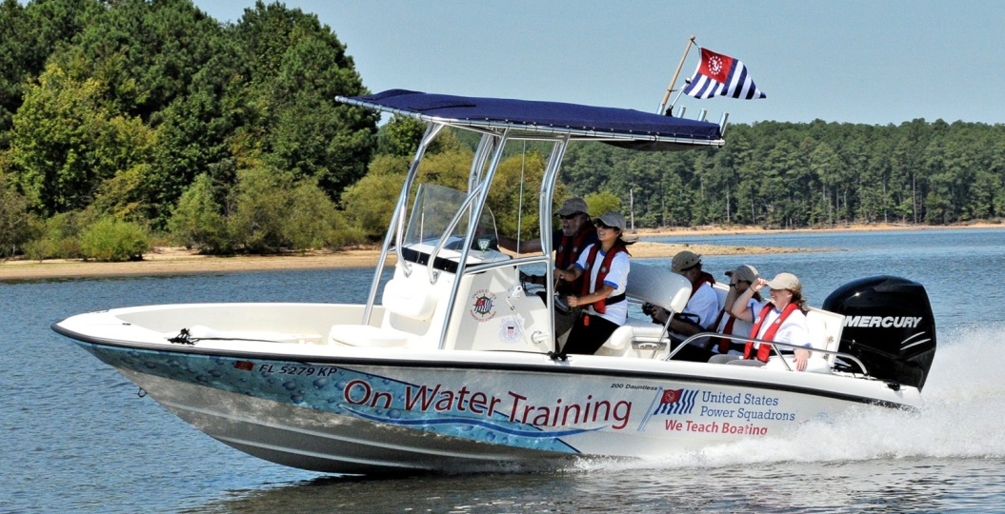
Jump Start Program for
New Boaters

Slide 24


Jump Start Program
One-on-one training for any new boat owner
Download manual online from the USPS website
Develop a custom program for the student
You will need:
The Student’s Boat
Water
Qualified
Instructor
Students
(One at a time)

Slide 25
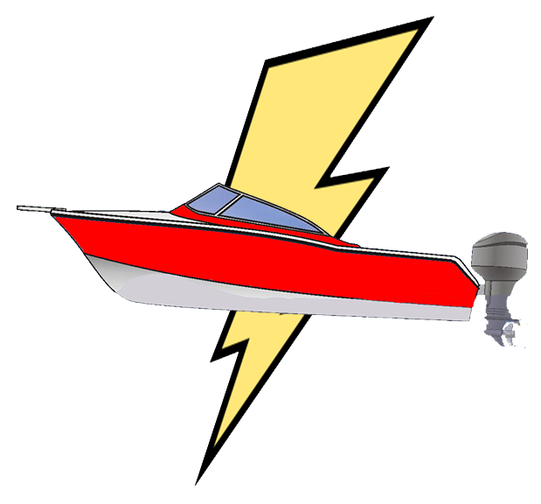
Jump Start Overview
Designed for New Boat Owners
One-on-One Training Session
Up to 2 Hours In Length
Customized to the needs of the individual boater
Can be used with members or non-members
No Cost Member Benefit

Slide 26
What it Includes
The Jump Start Program is a downloadable PDF document from the USPS BOC Web Site.
Included:
Protocol for Planning and Conducting Training
Script for Interviews
Recommendations for Exercises
Student Checklists and other material
Not Included
Student Course Book
Instructional details for skills
The program provides the framework. The instructor provides the knowledge and technique.

Slide 27


Jump Start – Who is a Candidate?
The Student:
Can be a Member or Non-Member
Owns a new boat (or new to them)
Boat may be large or small
Has some boating experience
Needs some help to get started with the new boat

Slide 28

Who Can Teach the Program
Any USPS Member who has taken a Basic Boating Course
Recommend the Instructors have completed the following:
  Instructor Development
  Seamanship/Boat Handling
  Advanced Powerboat Handling Seminar
  Hands On Training or BOC Inland Navigator
  Engine Maintenance
  Marine Electrical Systems

Slide 29
Jump Start Program
Under these USCG rules, squadrons can teach the “Jump Start” - Hands-on Training Program to both members and non-members
There is no fee to the student, so no license is required
Squadrons can benefit from new membership
Squadrons can use Hands-On Training as a valuable recruiting tool

Slide 30
Jump Start – How does it Work
Start with a Phone Interview
  Student’s Prior Experience
  Type of Boat, Location and Intended Use
  Boater’s Concerns
Plan the Training
  Discuss Possible Training Items
  Agree on the scope, date and time
Conduct the Training
  Follow the Training Plan
  Observe and Coach the Student
Follow Up
  Recommend Exercises
  Classroom and On-Water Training
Interview
Plan
Train
Follow-up

Slide 31
Student Interview
Objective of the Interview
Learn more about the needs of the Student
Agree on what will be covered in the Training
The Interview
Should be conducted at least several days in advance
This allows the instructor adequate time to prepare
The Interview should be conducted in person or over the phone

Slide 32
Planning the Training
Use the provided worksheet to build the lesson plan for the training session. Follow these steps:
Review the exercises discussed during the interview.
Add the requested exercises to the worksheet.
Identify those skills that are related and determine the best sequence to present them.
Determine if any other exercises should be included to support more advanced skills.
Calculate a reasonable time to conduct each exercise. Allow appropriate time for instruction, demonstration, and practice for each skill.
Trim the list in order to fit the time allotted for training.

Slide 33



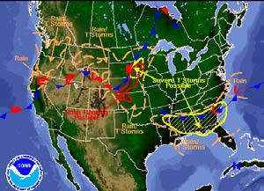

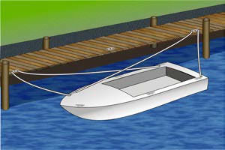

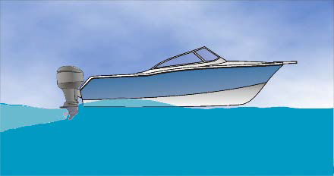
What To Include
Mandatory
  Vessel Safety Check
  Safety Procedures
  Weather Check
  Life Jackets worn at all times
Optional
  Equipment Review and Recommendations
  Trailering – Launching/Retrieving
  Docking – Leaving and Returning, Tying Up
  Close Quarters Maneuvering
  Open Water Maneuvering
Follow Up
  Training Exercises
  Course Recommendations
  Boating Aids – Checklists and Safety Materials

Slide 34
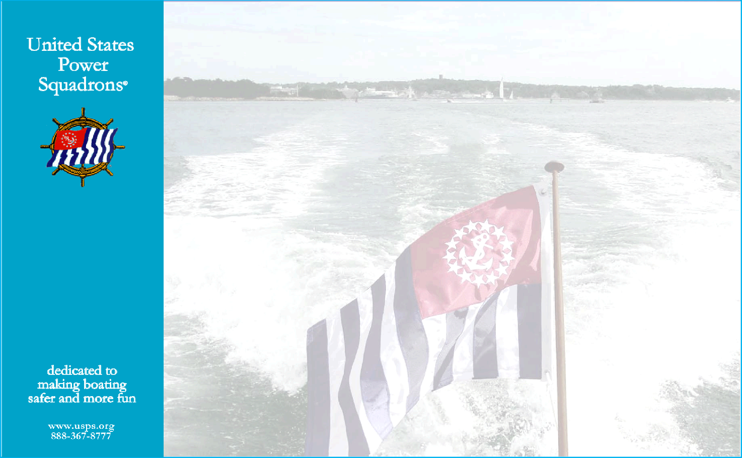
Certificate of Completion
Certificate of Completion
Awarded to
for successfully completing the
Jump Start Program
For
New Boat Owners
Squadron
Instructors
Date
This is not a membership certificate nor does it satisfy a state’s boating education requirements

Slide 35

Benefits of the Program
No cost involved
Low impact to the squadron
  2 hours on-the-water
  Boat and equipment provided by the student
No certifier training required
No USCG licensing requirements
Student gets the full attention of the instructor
Improved engagement of the new member
Promotes more classroom and on-the-water training

Slide 36
For More Information
For a copy of the Jump Start Program, see the document at the USPS Boat Operator Certification Web Page

Slide 37
Questions?
>>
Notes:
Why go through a Boat Operator Certification?
Here are some of the reasons to go through the effort of getting a Certification.
PAUSE & POINT
The lower four bullets are a little more speculative (an scary)

Slide 38
Boat Operator Certification
Started in 2006 – implemented late 2008
Four Levels
  Inland Navigator: Small Boat Operation
  Coastal Navigator: Coastal Piloting/Navigation
  Advanced Coastal Navigator: Coastal Piloting and Navigation Near Shore and with Reduced Visibility
  Offshore Navigator: Open Ocean Navigation
Notes:
The BOC program offers four different levels of certification for boating.
PAUSE & POINT
Certifiers provide, as their name suggests, a path for boaters to become certified to operate boats at different levels by demonstrating their boat handling skills on the water.
BOC Certifiers are trained and qualified through the USPS Instructor Development program.
Now through BOC, we have on the water certification capability - the drivers license!

Slide 39
Advantages to Members
Renting, chartering or leasing a boat, especially in another country
Obtaining insurance
Building confidence in your own abilities
Learning to teach others OTW
>>
Notes:
Why go through a Boat Operator Certification?
Here are some of the reasons to go through the effort of getting a Certification.
PAUSE & POINT
The lower four bullets are a little more speculative (an scary)

Slide 40
BOC Inland Navigator
Requirements:
NASBLA-approved course
Boat Handling
Engine Maintenance
Marine Electrical Systems
Four Seminars;
  How to use a Chart
  Onboard Weather
  GPS
  VHF Radio/VHF DSC
Demonstrate:
  Basic Boat Handling Skill
  Fire Extinguisher Skill
Notes:
Here are the prerequisites and skills necessary to take the OTW Certification for Inland Navigator.
Pause & Point

Slide 41
BOC Coastal Navigator
Requirements:
Completed Inland Navigation Certification
Marine Navigation
Weather
Marine Communications Systems
Seminars
  Mastering Rules of the Road
  Anchoring
  Mariner’s Compass
  Tides and Currents
  Radar
Demonstrate On-The-Water Navigation skills
Demonstrate Pyrotechnics (Signal Flares) skills
Notes:
Here are the prerequisites and skills necessary to take the OTW Certification for Coastal Navigator.
Pause & Point

Slide 42
Advanced Coastal Navigator
Requirements:
  Advanced Marine Navigation
  Marine Navigation Systems
  Cruise Planning
  Marine Radar
  Required Seminars
    Emergencies Onboard
    Rules of the Road
  Completed Advanced Coastal Navigation OTW skill including a restricted visibility navigation segment
  Complete First Aid
Notes:
The Advanced Coastal Navigator Certification program is almost completed and we have already undertaken several Beta tests of the Advanced Coastal skill demonstration.
Now a few answers to your questions about some Insurance issues.

Slide 43
Offshore Navigator
Requirements:
  Offshore Navigation or JN
  Marine Navigation Systems
  Cruise Planning
  Required Webinars
    Severe Weather
    500 Millibar chart/ Grib Files
  Completed Offshore Navigation OTW skill
  Complete First Aid and CPR Certs
Notes:
The Advanced Coastal Navigator Certification program is almost completed and we have already undertaken several Beta tests of the Advanced Coastal skill demonstration.
Now a few answers to your questions about some Insurance issues.

Slide 44
Certifiers must be trained for each specific level; e.g. IN, CN, ACN and ON
Requirements are similar to that for
Basic Power Boat Certifier.
Certifiers are qualified at the specific level by a Certifier Trainers
Certifiers
Notes:
We need teachers and trainers
and we need to let our potential “customers” know that this valuable program is available to them

Slide 45
Questions?
>>
Notes:
Why go through a Boat Operator Certification?
Here are some of the reasons to go through the effort of getting a Certification.
PAUSE & POINT
The lower four bullets are a little more speculative (an scary)

Slide 46

United States Power Squadrons®
Insurance for Training

Slide 47
What Does USPS Insurance Cover?
USPS insurance provides comprehensive coverage for on-the- water training. Coverage includes
General liability (on land)
Marine liability (docks, piers, and wharves)
On-the-Water liability
  Covers Teaching On the Water
  Includes hull damage up to the value of the boat
  Has a $250 Deductible
  Becomes the primary insurance when the first student or instructor boards the vessel for training
  Does not cover getting vessel to the training location
Professional liability for instructors

Slide 48
To Qualify for Insurance (1)
Documented Approval:
As for all USPS events, the activity must be approved by squadron, district, or national offices. Furthermore, this approval needs to be documented prior to the event in order to satisfy insurance requirements. Documentation of approval may include any of the following:
  Recording in Executive Committee Minutes
  Exchange of emails with squadron officers
  Newsletter, Calendar, or other publication

Slide 49
To Qualify for Insurance (2)
Approved Curriculum:
Follow a training curriculum approved by the Boat Operator Certification Committee. An approved curriculum will include the following:
  Each boat must have a current Vessel Safety Check
  Life jackets are worn at all times by all participants
  Conduct a weather check prior to departure
  Hold a dockside safety briefing

Slide 50
Document your Training Plan
Because Jump Start and On-the-Water Guides are flexible and can be adapted to meet individual training needs, it’s always a good idea to:
  Document your specific training plan before the event
  Share the training plan with your SEO

Slide 51
Who is Covered by the Insurance?
USPS Insurance covers the following organizations and individuals:
National
Districts
Squadrons
Officers/Directors
Members serving USPS
Outsiders volunteering service

Slide 52
Is the Students Boat covered?
Yes. As long as the boat has a current Vessel Safety
Check, Life Jackets are worn at all times, the weather is checked out in advance, and you hold a dockside briefing it can be used for training and USPS insurance will apply.
Note: Students boats should always be insured, but USPS insurance will become primary during approved training.

Slide 53
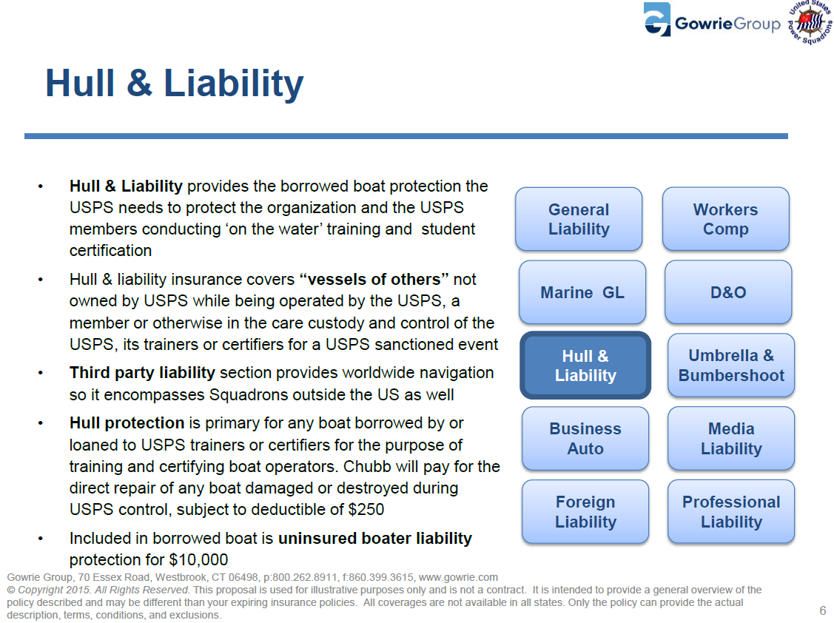

Slide 54
In Summary?
USPS provides a comprehensive insurance program that covers the individuals and boats involved in on-the- water training. As long as you follow the simple rules outlined here, you will be covered.
If you have any further question on the insurance program, you can contact the insurance company directly. Contact information is available on the USPS Treasurer’s web site.

Slide 55
United States Power Squadrons®
Is a U.S. Coast Guard Licensing Required?

Slide 56
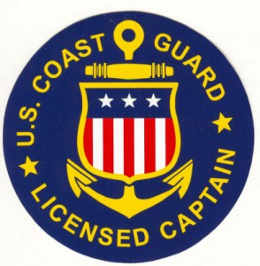
When is a USCG License Required?
You need a license to operate a small passenger vessel when both of these conditions exist:
The boat is carrying passengers for hire
The vessel is being operated in “navigable waters” under USCG jurisdiction
The USCG is the only organization that can enforce the licensing requirements.

Slide 57
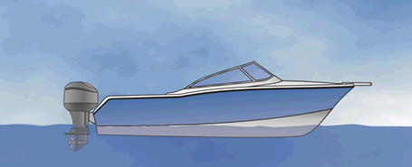

What is a “Passenger for Hire”?
Passenger for Hire means a passenger for whom consideration is contributed as a condition of carriage on the vessel, whether directly or indirectly flowing to the owner, charterer, operator, agent, or any other person having an interest in the vessel.
=

Slide 58
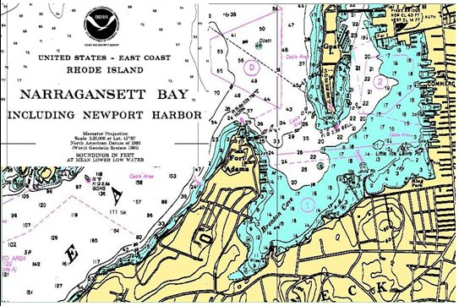
What are “Navigable Waters”?
Generally, navigable waters are defined as those waters that are subject to the ebb and flow of tide, plus any other waters that might possibly be used for interstate or foreign commerce.
The USCG is responsible for determining which waters are considered navigable.
To determine if a specific body of water is under USCG jurisdiction, contact the nearest Coast Guard Sector Office

Slide 59
How do you avoid needing a License
You do not need a license if any one of the following conditions exists:
You are teaching on waters not under USCG jurisdiction
You do not charge the student a fee as a condition of going on the water
You are teaching on a boat that is owned by one of the students

Slide 60
For Further Information
Visit the BOC Web Page:
  https://www.usps.org/index.php/departments/13000/13700-on-the-water-training-certification
Contact your BOC Regional Director:
  https://www.usps.org/images/eddept/files/BOC_and_OTW_Training_Programs/BOC_Regional_Directors.pdf
Contact the BOC Committee:
  https://www.usps.org/index.php/departments/13000/13700-on-the-water-training-certification

Slide 61
Questions?
Contact: John Locke
Phone: 443 262-6892
Email: locke806@gmail.com
>>
Notes:
Why go through a Boat Operator Certification?
Here are some of the reasons to go through the effort of getting a Certification.
PAUSE & POINT
The lower four bullets are a little more speculative (an scary)

